Slide 1
Resources for pharmacies
Promotional pack

Slide 2
Overview
Following a successful 12-month pilot, the Community Pharmacist Program is now an ongoing, statewide service.
From November 2025, the program will be promoted as Chemist Care Now to the public and a paid advertising campaign will run across Victoria to help build awareness of the program and treatments available.
Current treatments include:
Treatment for herpes zoster (shingles) (aged 18 years and over)
Treatment for a flare up of mild plaque psoriasis (aged 18 years and over)
Resupply of select oral contraceptive pills without a prescription for people who are taking the oral contraceptive pill (aged 16 - 50 years)
Treatment for uncomplicated urinary tract infections in women and gender diverse people (aged 18 – 65 years)
Pharmacist immunisers can provide some vaccinations for travel and other health vaccines including hepatitis A, hepatitis B, poliomyelitis and typhoid.
Over the next two years, additional common health conditions and wellbeing services will be introduced to the Community Pharmacist Program, bringing the total to 22 services pharmacists can offer.
A range of marketing materials to promote Chemist Care Now are available in this pack. To ensure consistency of branding, the Department of Health asks participating pharmacies to use the provided communications materials in their promotion of Chemist Care Now services.
They are all available from the web page Victorian Community Pharmacist Program – Resources for Pharmacists. These materials will continue to be reviewed and more will be added as the campaign rolls out.

Slide 3
About the advertising campaign
The paid advertising campaign will be in market across Victoria from Monday 17 November to early June 2026.
The campaign will aim to raise awareness of Chemist Care Now and the current treatments available. It will appear across regional TV, video, outdoor, regional press, radio and paid social media channels.
The Chemist Care Now website page on the Better Health Channel www.chemistcarenow.vic.gov.au will serve as the ‘single source of truth’ for public messaging and lists participating pharmacy details.
Please use this website address when promoting Chemist Care Now services.

Slide 4
Referring to Chemist Care Now
If your pharmacy would like to reference Chemist Care Now on your website or own branded advertising, please include the Victorian Government logo and the following line:
"Chemist Care Now is part of the Community Pharmacist Program, supported by the Victorian Government.”
Please contact the Department of Health’s Marketing team for review and approval of any advertising material or use of the Victorian Government logo.
Campaigns@health.vic.gov.au

Slide 5
Marketing resources
Download for use

Slide 6
Key messages
Please use these messages when communicating publicly about your service.
In Victoria, chemists are now treating more conditions without the need for a visit to the GP.
When you've run out of the contraceptive pill, get it at the chemist.
If you have a UTI and need to get it treated, get it at the chemist.
Think you might have shingles, and need treatment, get it at the chemist.
From UTI treatments to psoriasis and more, save time and get it at the chemist.
There are over 800 chemists across Victoria participating in Chemist Care Now – and the list is growing.
Give your chemist a call before you go to check what treatments are available or if you need to book ahead.
After consulting your chemist, GP follow up is always recommended.
To find participating chemists and available treatments go to chemistcarenow.vic.gov.au
Chemist Care Now is part of the Community Pharmacist Program, supported by the Victorian Government

Slide 7
Newsletter article
Chemist Care Now. Save time and get it at the chemist.
In Victoria, chemists are now treating more conditions without the need for a visit to the GP.
From UTIs to contraceptive pill refills, shingles treatments and more, Chemist Care Now can save you time by getting care at the chemist.
You can attend a chemist for treatment of the following common health concerns:
Requesting a resupply of the oral contraceptive pill without needing a prescription.
Treatment for urinary tract infections.
Treatment for shingles
Treatment for a flare up of mild plaque psoriasis
Some travel vaccines
Over the next two years, additional common health conditions and wellbeing services will be introduced to Chemist Care Now, bringing the total to 22 services chemists can offer.
Consultations with your pharmacist are free, you just pay for your medicines. To find participating chemists and available treatments go to chemistcarenow.vic.gov.au

Slide 8
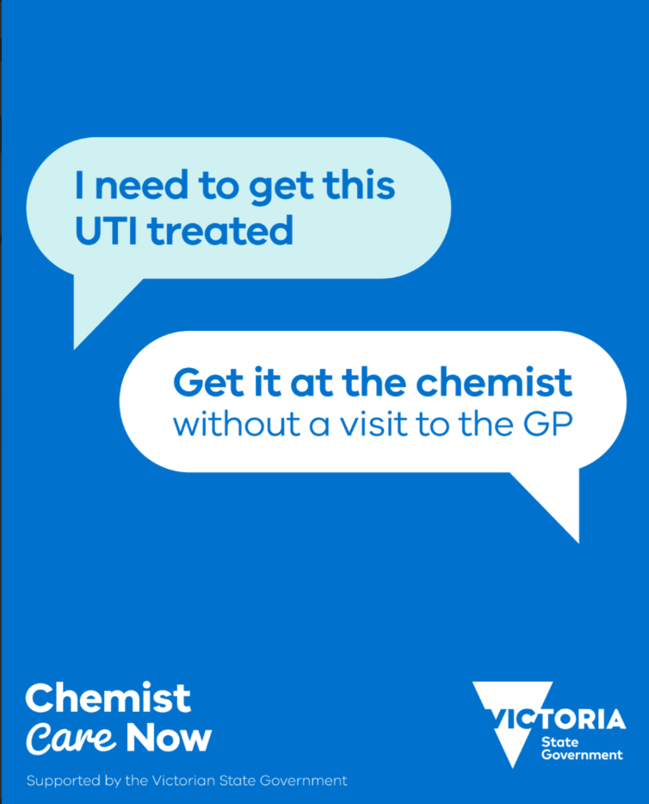

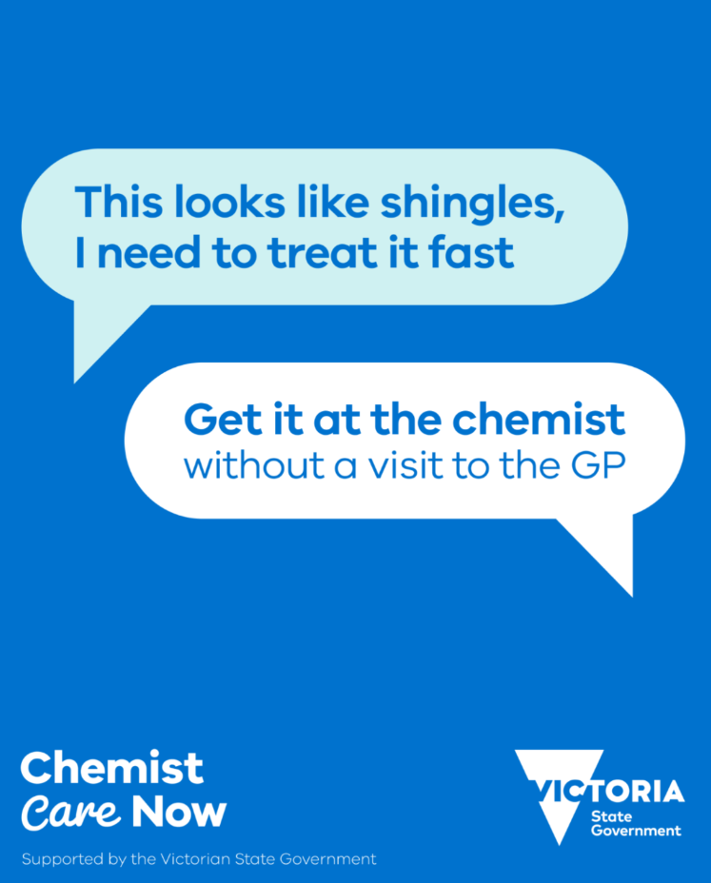
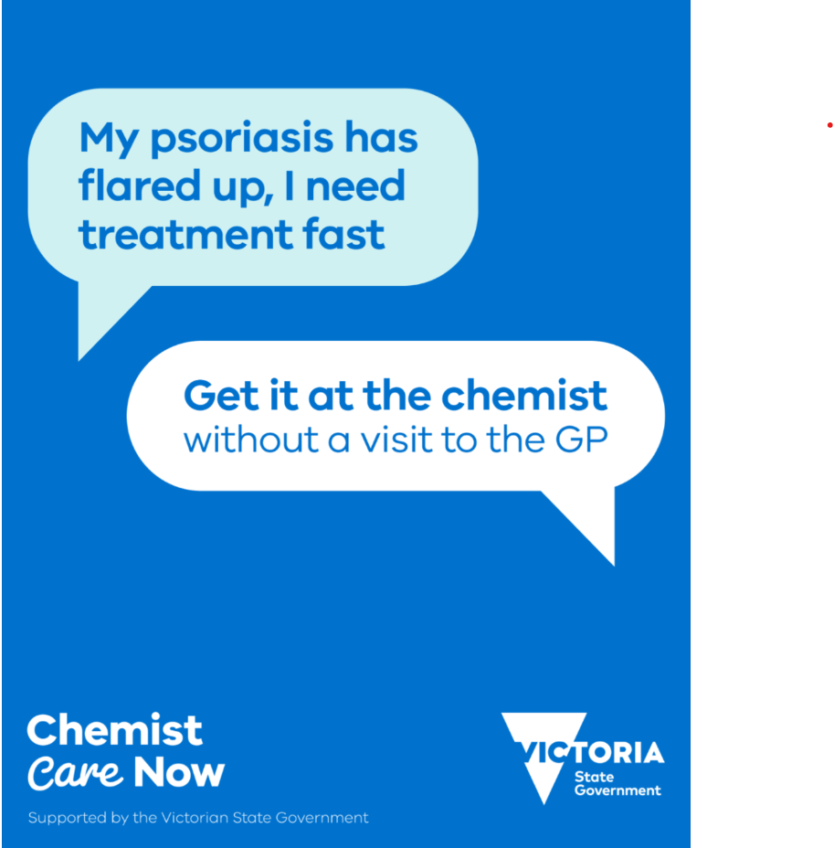

Social media tiles and copy
Suggested copy:
Our chemist is now treating more conditions without the need for a visit to the GP.
From UTI treatments to psoriasis and more, save time and get it at the chemist.
Ask us what treatments we can help you with or visit chemistcarenow.vic.gov.au for more information.
Download social tiles

Slide 9

Poster
Download poster

Slide 10



Point of sale and signage
Window decal
A-frame 600 x 900
Counter card A6
Download assets
Floor decal

Slide 11
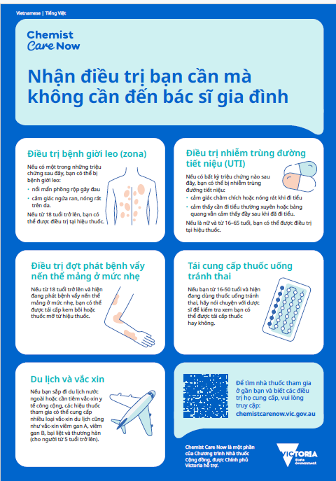
Translated fact sheets
Translated fact sheets are available in:
Arabic
Chinese simplified
Chinese Traditional
Greek
Italian
Punjabi
Turkish
Vietnamese
Download translated fact sheets

Slide 12
Thank you
For more information or queries please contact AdminCommunityPharmacistPilot@health.vic.gov.au.

